Slide 1
LGB
OPERATIONS TECHNOLOGY
Oct 2026
Monthly Project Progress
Software & IOT
Annur• PGR • K-palayam • FPD
LGB | Operations Technology

Slide 2
YEARLY PLAN - PROJECTS 2026
2026 Projects Plan
S.No | Project Name | Project Description | Status | Plant | Start Month | End Month
Digitization - Existing Projects
1 | Furnace | A furnace monitoring and inspection system that ensures process quality, safety compliance, and operational parameter checks during heat treatment operations. | Completed & Running | Pongalur, Vaiyampalaym,Chennai,Annur(In progress) | 24 SEP 25 | 16 FEB 26
2 | Operator Buddy | A digital assistant system that guides shop-floor operators through tasks, checks, and data entry to ensure correct and efficient production activities. | Completed & Running | Kpalaym,Pongalur,Ppalayam,Annur | 04 APR 25 | 20 JAN 26
3 | Press Digitilization | It enables tracking, compliance, and lifecycle management of equipment and related activities across the shop floor. | Completed & Running | PONGALUR, ANNUR & CHENNAI | 02 JUNE 25 | 21 JAN 26
4 | PRISM | A Manufacturing Execution System that integrates and reports real-time production data from shop floor operations for monitoring and control. | Completed & Running | Kpalaym,Pongalur, Ppalayam, Annur,Vaiyampalayam,chennai | 14 APR 25 | 14 JAN 26
5 | AI Production | An AI-driven furnace analytics system that monitors utilization, charge parameters, cycle time, and setpoint deviations to evaluate process performance and quality in real time. It provides RED/GREEN insights, target attainment analysis, and operational dashboards to optimize furnace efficiency and compliance. | Initated and Testing In progress | COE (Testing) | JAN 26 | JUNE 26
6 | SFQA(Shopfloor Quality Assist) | A system or process that supports real-time quality inspection and assurance activities directly on the manufacturing shop floor. | Completed & Running | Kpalayam,Ppalayam,pongalur | 10 OCT 24 | 10 APR 25
7 | AssetHub | A centralized asset management platform that integrates modules such as metallurgy, instrument calibration, and operational checklists to manage manufacturing assets and quality processes. | Completed & Running | Pongalur,ppalayam,kpalayam | 20 JUNE 25 | 05 JAN 26
8 | OTNEXUS | OTNexus is a centralized web-based industrial utility platform that provides essential engineering, production, quality, IT, and business tools. | Inprogress | Common for all plant | 02 JUNE 26 | 05 JULY 26
9 | Servo 8T press machine | SFQA is an automated quality validation and traceability system integrated with the 8T Press Servo Machine and PLC to prevent incorrect assembly and ensure product quality. | Completed | P.Palayam | 07 JUNE 26 | 26 JULY 26
10 | Kit Packing | The Kit Packing Application prevents incorrect kit dispatch by ensuring the right components are packed for the right order. It enables complete reverse traceability of every kit, ensuring transparency and accountability throughout the dispatch process. | Inprogress | Ganapathy | 25 Aug 26 | 30 Nov 26
LGB l Operations Technology

Slide 3
YEARLY PLAN - PROJECTS 2026
2026 Projects Plan
S.No | Project Name | Project Description | Status | Plant | Start Month | End Month
Digitization - Existing Projects
11 | FPD Press Phase 2 | It enables tracking, compliance, and lifecycle management of equipment and related activities across the shop floor at banglore jalna pantnagar lsp FPD2 | Inprogress | All FPD Plants | 07 Oct 2026 | 25 Dec 2026
12 | SMD | Air bag stitch analysis | Inprogress | SMD | 03 Sept 2026 | 23 Oct 2026
LGB l Operations Technology

Slide 4
01
Furnace

Slide 5
Furnace - PHASE 1 ( Oct PLAN vs ACTUAL )
Furnace - PHASE 1
Task ID | Task Description | Team | Planned |  | Actual |  | Status | Responsibility | Remarks
 |  |  | Start Date | End Date | Start Date | End Date
1 | CP data in single report should be in float type. | Software | 08-Oct-2026 | 10-Oct-2026 | 08-Oct-2026 | 10-Oct-2026 | Close | Durga,vishnunirmalan
2 | Process Integration from pre heat to tempering - report | Software | 01-Oct-2026 | 04-Oct-2026 | 01-Oct-2026 | 04-Oct-2026 | Close | Durga,vishnunirmalan
3 | Excel mapping to PRISM, Red Charge & Green Charge based on set time and set point. | Software | 21-Oct-2026 | 24-Oct-2026 |  |  | In-Process | Durga,vishnunirmalan | Demo to SQF team
4 | Charge comparison report for same part number across furnaces and different part numbers in same furnace. | Software | 20-Oct-2026 | 23-Oct-2026 |  |  |  | Durga,vishnunirmalan
5 | Furnace utilization comparison dashboard/report. | Software | 22-Oct-2026 | 23-Oct-2026 |  |  |  | Durga,vishnunirmalan
6 | Energy dummy data loading for different charges and part numbers. | Software | 24-Oct-2026 | 27-Oct-2026 |  |  |  | Durga,vishnunirmalan
7 | Single chart report as main dashboard. | Software | 13-Oct-2026 | 14-Oct-2026 | 14-Oct-2026 | 14-Oct-2026 | Close | Durga,vishnunirmalan
8 | Auto History Card printing based on work order, part number and telemetry data. | Software | 10-Oct-2026 | 15-Oct-2026 | 13-Oct-2026 |  |  | Durga,vishnunirmalan | Waiting for template comformation
9 | Instrument calibration due monitoring and API integration to PRISM. | Software | 20-Oct-2026 | 27-Oct-2026 |  |  |  | Durga,vishnunirmalan
LGB l Operations Technology

Slide 6
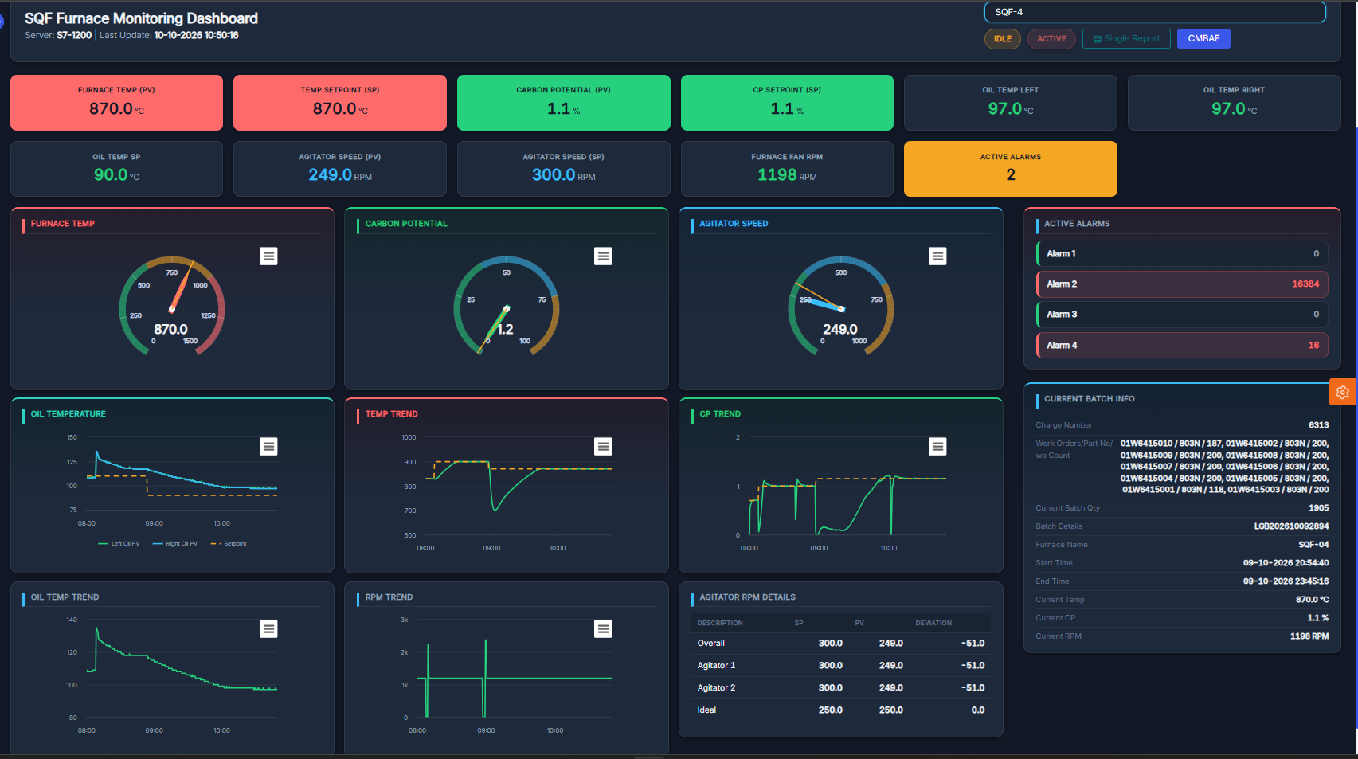
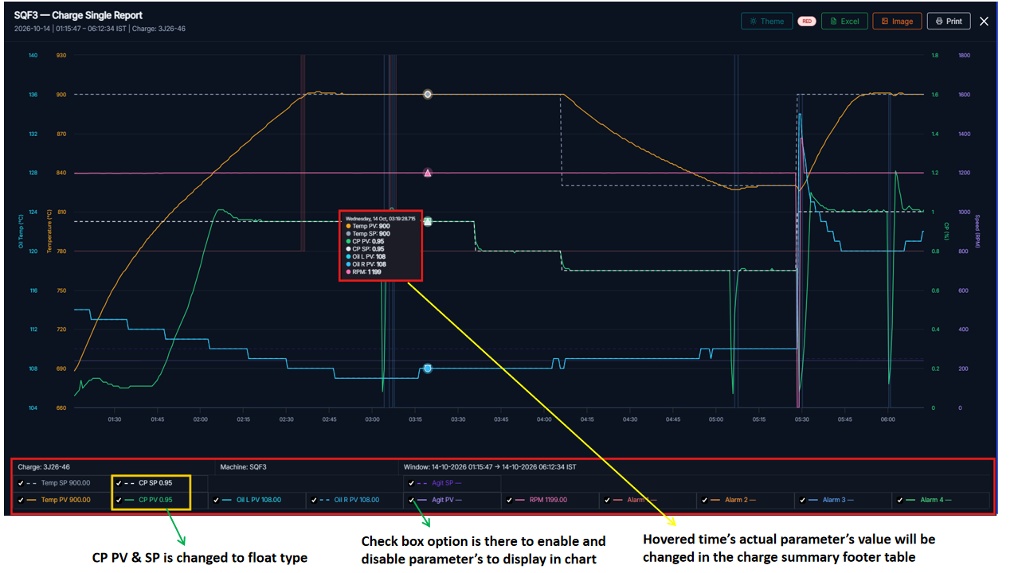
Furnace DASHBOARD
LGB l Operations Technology

Slide 7
02
Operator Buddy

Slide 8
Operator Buddy - PHASE 2 OCTOBER PLANNED TASK
Operator Buddy - Phase 2
Task ID | Task Description | Team | Planned |  | Actual |  | Status | Responsibility | Remarks
 |  |  | Start Date | End Date | Start Date | End Date
Development & Deployement
1 | First stage entry in operator buddy (SAP not integrated - POC) | Software | 3-Oct-26 | 7-Oct-26 | 3-Oct-26 | 7-Oct-26 | Close | Durga
2 | Assembly stage entry development | Software | 10-Oct-26 | 16-Oct-26 | 14-Oct-26 |  | Open | Hariharasudhan | SAP Team review
3 | Plan Vs Actual in WIP screen | Software | 01-Oct-26 | 05-Oct-26 | 08-Oct-26 | 12-Oct-26 | Close | Durga | Plant review
4 | Process Integration from pre heat to tempering | Software | 01-Oct-2026 | 04-Oct-2026 | 01-Oct-2026 | 04-Oct-2026 | Close | Durga,vishnunirmalan
LGB l Operations Technology

Slide 9
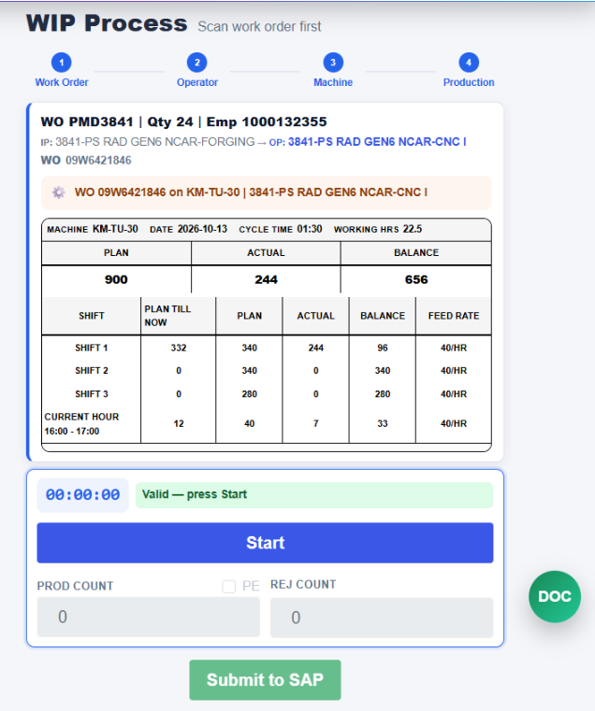
OPERATOR BUDDY PLAN VS ACTUAL
Operator Buddy - PHASE 2 OCTOBER PLANNED TASK

Slide 10
03
Press Digitilization

Slide 11
Press Digitilization - PHASE 2 OCTOBER PLANNED TASK
Press Digitilization
Task ID | Task Description | Team | Planned |  | Actual |  | Status | Responsibility | Remarks
 |  |  | Start Date | End Date | Start Date | End Date
Development & Deployement
1 | KG Conversion - Maestro | Software | 3-Oct-26 | 30-Oct-26 | 16-Oct-26 |  | Open | Vishnunirmalan | Not started
2 | Work order completion alarm - Maestro | Software | 10-Oct-26 | 16-Oct-26 |  |  | Open | Maestro | post KG conversion
3 | Maestro Stroke count into Prism Dashboard | Software | 01-Oct-26 | 05-Oct-26 | 01-Oct-26 | 05-Oct-26 | Close | Hariharasudhan
4 | Maestro Report Replication | Software | 12-Oct-2026 | 16-oct-26 | 12-oct-26 | 14-oct-26 | Closed | Naveen
5 | 15 FPD Digitilization (LSP,FPD 2, Jalna,Pantnagar,Nagpur,Banglore) | IoT | 06-Oct-26 | 30-Oct-26 | 07-Oct-26 |  | Open | Vishnunirmalan | LAN Survey
6 | Elcon Device Dashboard | Software | 07-Oct-26 | 10-Oct-26 | 14-Oct-26 | 15-Oct-26 | Close | Vishnunirmalan
LGB l Operations Technology

Slide 12
S.No | Category | Topic | Planned start date | Planned end date | Actual start date | Actual end date | Status | Remarks
1 | Daily Dashboard | Daily Activity Report | 06-Oct-2026 | 06-Oct-2026 |  |  | Pending
2 |  | Single Machine Perfomance Report | 06-Oct-2026 | 06-Oct-2026 |  |  | Pending | Mastero Need to send file idel
3 |  | Production Report for Single day | 08-Sep-2026 | 08-Sep-2026 | 10-Sep-2026 |  | Pending | The shift filter issue needs to be fixed, and cavity data from the Maestro application needs to be retrieved and stored in MongoDB.
4 |  | Machine Stroke Report by Hour | 08-Sep-2026 | 08-Sep-2026 | 10-Sep-2026 | 10-Sep-2026 | Completed
5 |  | Daily Machine Stroke Report | 08-Sep-2026 | 08-Sep-2026 | 14-Sep-2026 |  | In Progress | The downtime reason is not being received in MongoDB from the Mastero application.
6 |  | Single day Machine downtime Report | 09-Sep-2026 | 09-Sep-2026 | 17-Sep-2026 |  | In Progress | There is a data mapping issue from PRISM.
7 |  | Per day machine Report | 09-Sep-2026 | 09-Sep-2026
8 |  | Downtime Employee Report | 12-Sep-2026 | 12-Sep-2026
9 |  | Downtime Reason Report | 12-Sep-2026 | 12-Sep-2026 | 18-Sep-2026
10 |  | Machine Consumption Report | 14-Sep-2026 | 14-Sep-2026 |  |  | Pending
12 | Report Dashboard | Downtime Comparison Report | 21-Sep-2026 | 22-Sep-2026 |  |  | Pending
13 |  | Downtime Employee Datewise | 21-Sep-2026 | 22-Sep-2026
14 |  | Downtime Reason Report | 15-Sep-2026 | 17-Sep-2026 | 17-Sep-2026 |  | In Progress | Downtime data wants to recieve in DB from Mastero Application
15 | Machine Dashboard | Machine Dashboard | 15-Sep-2026 | 19-Sep-2026 | 16-Sep-2026 | 17-Sep-2026 | In Progress | The machine completion status is showing in the dashboard, but the start and end times are not being received from Mastero in MongoDB.
16 | Production Reports | Production Report | 24-Oct-2026 | 24-Oct-2026 |  |  | Pending | Add the cavity count from the Maestro application to MongoDB.
17 |  | Cycle Report |  |  |  |  |  | No data from Maestro Report
18 |  | Work Report | 24-Oct-2026 | 24-Oct-2026
19 |  | Work Order Plan Report |  |  |  |  |  | No data from Maestro Report
20 |  | Work Flow Report |  |  |  |  |  | Qc Checker , Not Recieved from DB
21 |  | Work Performance Report |  |  |  |  |  | No data from Maestro Report
22 |  | Work Consumption Report |  |  |  |  |  | No data from Maestro Report
23 |  | Production Insight Report | 28-Oct-2026 | 28-Oct-2026 |  |  |  | Add the cavity count from the Maestro application to MongoDB.
24 |  | Comparitive Analysis | 29-Oct-2026 | 29-Oct-2026 |  |  |  | Rejection Qty to be added in mongodb instead of 0
25 |  | Single day production quantity report | 29-Oct-2026 | 29-Oct-2026 |  |  |  | Add the cavity count from the Maestro application to MongoDB and Planned Qty.
26 |  | Part wise stroke report | 30-Oct-2026 | 30-Oct-2026 |  |  |  | Part field to be there in workorder status of mongoDB
27 |  | Part qty date wise report | 30-Oct-2026 | 30-Oct-2026 |  |  |  | Part field to be there in workorder status of mongoDB
28 |  | Machine part wise report | 31-Oct-2026 | 31-Oct-2026 |  |  |  | Part field to be there in workorder status of mongoDB
29 |  | Part spm report | 18-Sep-2026 | 18-Sep-2026 | 19-Sep-2026 | 19-Sep-2026 | Completed
30 |  | Planned / Actual | 18-Sep-2026 | 18-Sep-2026 |  |  | Pending | Planned data not coming in the DB
30 |  | Part qty hour wise stroke | 18-Sep-2026 | 18-Sep-2026 | 19-Sep-2026 | 19-Sep-2026 | Completed
31 | Downtime Reports | Downtime statistics | 17-Sep-2026 | 17-Sep-2026 | 16-Sep-2026 | 18-Sep-2026 | In Progress | The current completion data is available, but some data is missing from the Mastero application .
32 |  | Downtime report | 17-Sep-2026 | 17-Sep-2026 | 18-Sep-2026 | 19-Sep-2026 | In Progress | The downtime reason is missing in MongoDB because it is not being received from the Mastero application.
33 |  | Single day downtime report | 21-Sep-2026 | 21-Sep-2026 | 22-Sep-2026 | 23-Sep-2026
34 |  | Downtime hour basic | 21-Sep-2026 | 21-Sep-2026 | 22-Sep-2026 | 23-Sep-2026
37 | Machine Reports | Hour Wise for all machine | 02-Nov-2026 | 02-Nov-2026 |  |  | Pending
38 |  | Stroke Report | 02-Nov-2026 | 02-Nov-2026
39 |  | Machine Spm Report | 03-Nov-2026 | 03-Nov-2026
40 |  | Machine Activity Report | 03-Nov-2026 | 03-Nov-2026

Slide 13
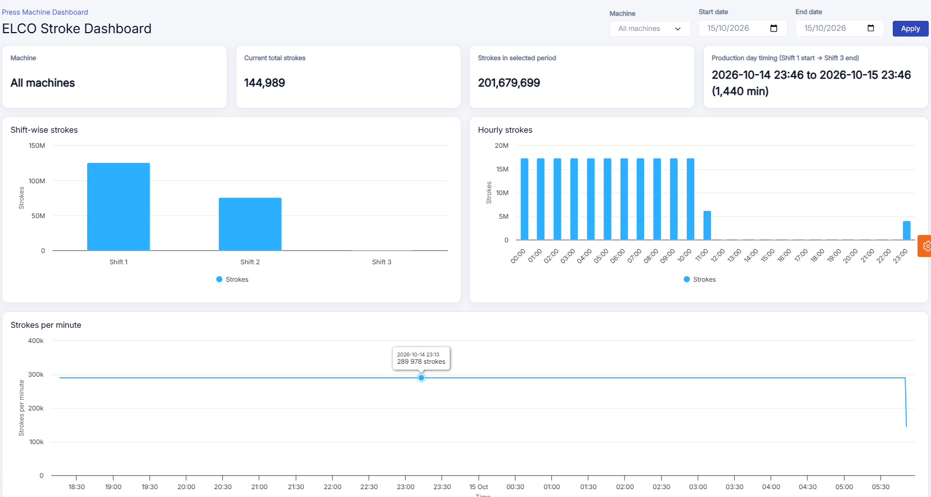

Slide 14
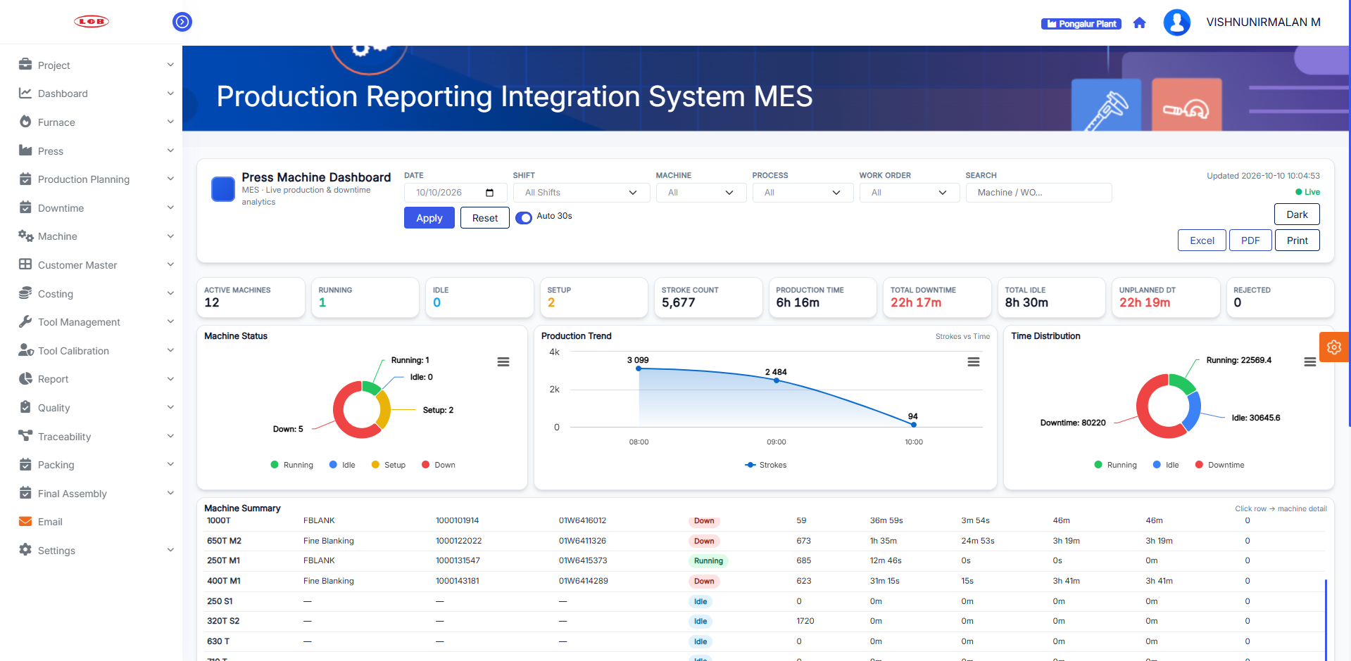
PRISM PRESS DASHBOARD
Press Dashboard In PRISM
LGB l Operations Technology

Slide 15
04
PRISM

Slide 16
PRISM - PHASE 2 OCTOBER PLANNED TASK
PRISM
Task ID | Task Description | Team | Planned |  | Actual |  | Status | Responsibility | Remarks
 |  |  | Start Date | End Date | Start Date | End Date
Development & Deployement
1 | Machine Monitoring | Software | 06-Oct-26 | 17-Oct-26 | 6-Oct-26 |  | In Progress | Durga | Under development
2 | All Reports Optimization | Software | 20-Oct-26 | 24-Oct-26 |  |  | Open | Durga | Not Started
3 | Prepacking Optimization | Software | 12-Oct-26 | 12-Oct-26 | 12-Oct-26 | 12-Oct-26 | Closed | Naveen | Completed
LGB l Operations Technology

Slide 17
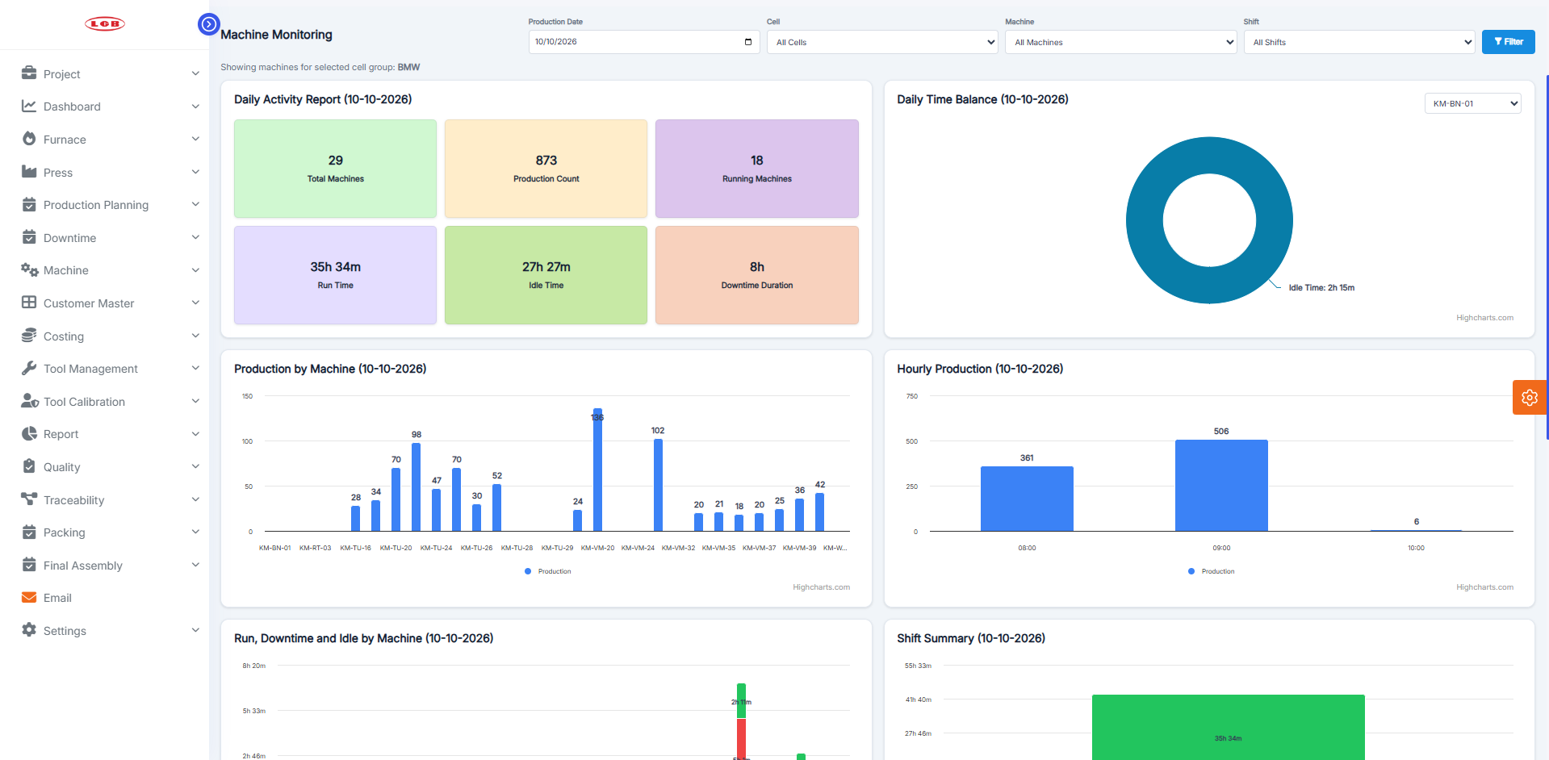
PRISM CNC DASHBOARD
CNC Dashboard In PRISM
LGB l Operations Technology

Slide 18
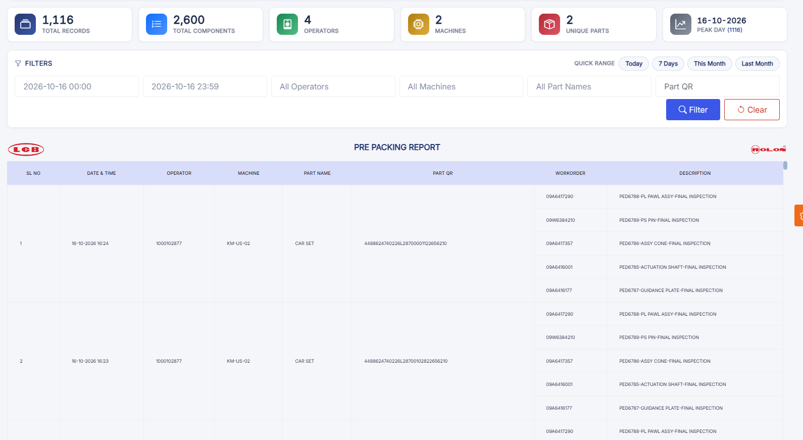
PRISM PREPACKING REPORT
PREPACKING REPORT
LGB l Operations Technology

Slide 19
05
Kit Packing

Slide 20
KIT PACKING PROJECT – WBS / PROJECT SCHEDULE
STO → Feasibility → Packing → Parent Label → SAP Production Entry → ATD → Invoice → Dispatch
S No. | Task Description | Duration (Days) | Planned Start | Planned Finish | Actual Start | Actual Finish | Remarks | Status | % Completion
1.00 | INITIATE & REQUIREMENT CONFIRMATION
1.01 | Review KIT packing business requirement |  | 25.08.2026 | 30.08.2026 | 25.08.2026 | 30.08.2026 |  | Completed | 100%
1.02 | Confirm end-to-end process with requester |  | 02.09.2026 | 10.09.2026 | 02.09.2026 | 10.09.2026 |  | Completed | 100%
1.03 | Confirm project scope, deliverables and priorities |  | 10.09.2026 | 16.09.2026 | 10.09.2026 | 16.09.2026 |  | Completed | 100%
1.04 | Raise BAPI requirements / requisition to SAP team |  | 16.09.2026 | 23.09.2026 | 16.09.2026 | 23.09.2026 |  | Completed | 100%
2.00 | SAP INTEGRATION
2.01 | STO Plan – BAPI integration and SAP data fetching |  | 24.09.2026 | 25.09.2026 | 24.09.2026 | 25.09.2026 |  | Completed | 100%
2.02 | Feasibility – BAPI integration and SAP data fetching |  | 29.09.2026 | 30.09.2026 | 29.09.2026 | 30.09.2026 |  | Completed | 100%
2.03 | Production Entry – finalize BAPI with SAP team |  | 12.10.2026 | 15.10.2026 |  |  |  | Completed | 100%
2.04 | ATD Location – finalize BAPI/interface with SAP team |  | 12.10.2026 | 15.10.2026 |  |  |  | Completed | 100%
2.05 | Invoicing – finalize BAPI/interface with SAP team |  | 12.10.2026 | 15.10.2026 |  |  | Fields to be confirmed with SAP for Production entry after demo | Pending | 0%
3.00 | UI DEVELOPMENT & PACKING PROCESS
3.01 | Daily plan UI – STO and feasibility display |  | 11.09.2026 | 15.09.2026 | 11.09.2026 | 15.09.2026 |  | Completed | 100%
3.02 | Packing screen development |  | 16.09.2026 | 18.09.2026 | 16.09.2026 | 18.09.2026 |  | Completed | 100%
3.03 | Kit scanning and packing validation |  | 29.09.2026 | 30.09.2026 | 29.09.2026 | 30.09.2026 |  | Completed | 100%
3.04 | Parent QR / Parent Label generation |  | 18.09.2026 | 21.09.2026 | 18.09.2026 | 21.09.2026 |  | Completed | 100%
3.05 | Packing transaction / status handling |  | 01.10.2026 | 03.10.2026 | 01.10.2026 |  |  | Completed | 100%
4.00 | SAP COMPLETION & END-TO-END PROCESS
4.01 | Production entry after parent label generation |  | 15.10.2026 | 17.10.2026 | 16.10.2026 |  | Waiting for quality data from plant to test production entry SAP posting | In progress | 50%
4.02 | Packed stock management |  | 18.10.2026 | 19.10.2026 |  |  |  | Pending | 0%
4.03 | ATD automatic location assignment |  | 20.10.2026 | 25.10.2026 |  |  |  | Pending | 0%
4.04 | Manual ATD assignment / override |  | 20.10.2026 | 25.10.2026 |  |  |  | Pending | 0%
4.05 | Invoice generation and SAP integration |  | 26.10.2026 | 31.10.2026 |  |  |  | Pending | 0%
4.06 | Transporter / LR details and label flow |  | 01.11.2026 | 05.11.2026 |  |  |  | Pending | 0%
5.00 | TESTING, DEMO & VALIDATION
5.01 | Demo preparation – STO + Feasibility + Packing + Parent Label |  |  |  |  |  |  | Ready for Demo | 100%
5.02 | Demo to requester and collect feedback |  | 10.11.2026 | 11.11.2026 |  |  | Not yet given | Pending | 0%
5.03 | Requirement changes / final scope freeze |  | 12.11.2026 | 14.11.2026 |  |  |  | Pending | 0%
5.04 | SAP integration testing |  | 16.11.2026 | 17.11.2026 |  |  |  | Pending | 0%
5.05 | End-to-end testing / UAT |  | 17.11.2026 | 18.11.2026 |  |  |  | Pending | 0%
6.00 | FINAL HANDOVER & GO-LIVE
6.01 | Final demo and business approval |  | 18.11.2026 | 22.11.2026 |  |  |  | Pending | 0%
6.02 | Production deployment |  | 23.11.2026 | 25.11.2026 |  |  |  | Pending | 0%
6.03 | Project handover / go-live |  | 26.11.2026 | 30.11.2026 |  |  |  | Pending | 0%
LGB l Operations Technology

Slide 21
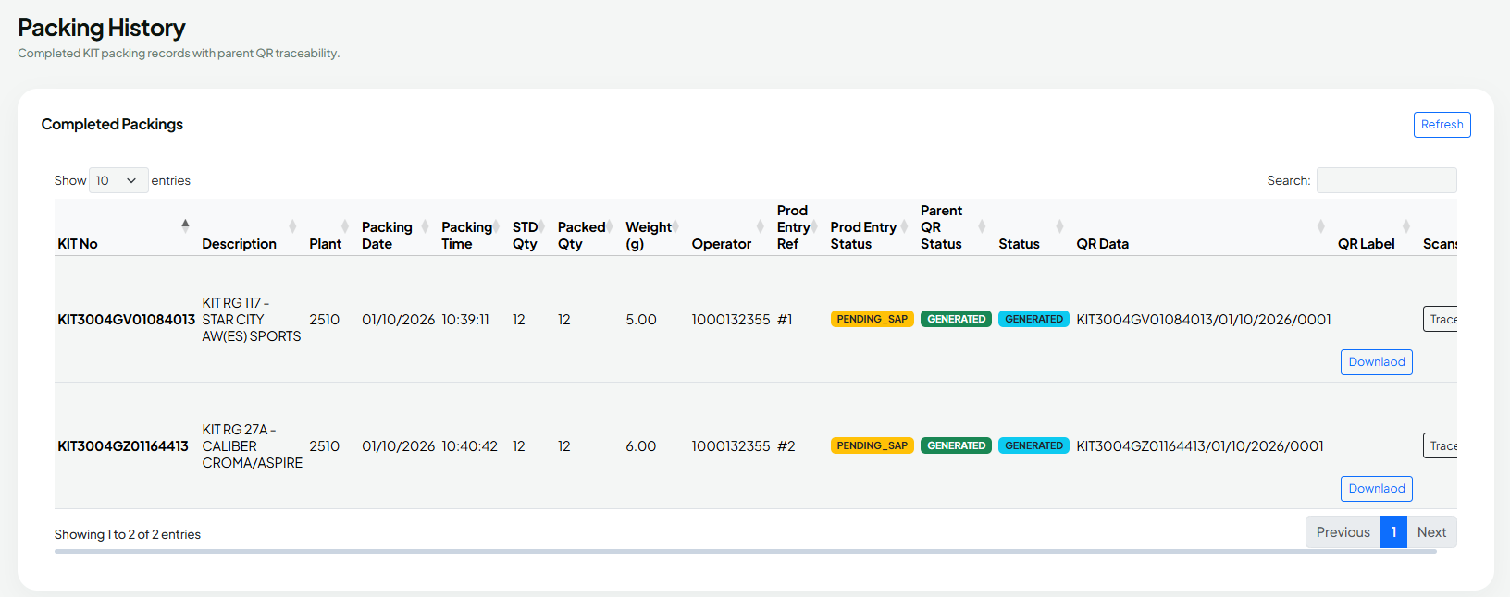
KIT PACKING HISTORY REPORT
Kit Packing History Dashboard
LGB l Operations Technology

Slide 22
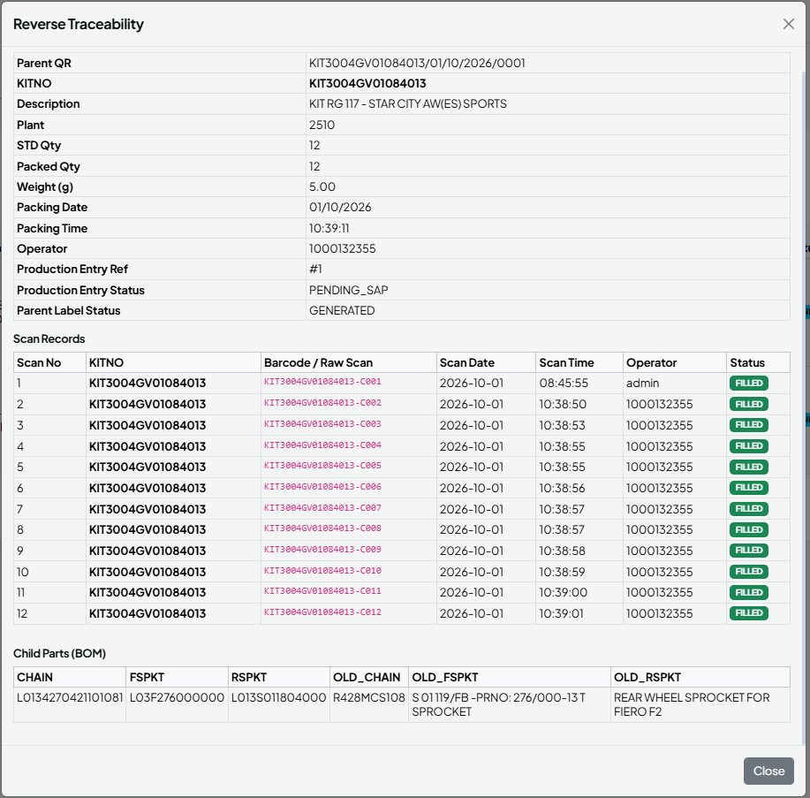
KIT PACKING REVERSE TRACEABILITY CARD
Kit Packing Reverse Traceability
Report
LGB l Operations Technology

Slide 23
06
SMD - AIRBAG STITCH PATTERN ANALYSIS – WBS / PROJECT SCHEDULE

Slide 24
AIRBAG STITCH PATTERN ANALYSIS – WBS / PROJECT SCHEDULE
Requirements → Camera Setup → Dataset → Segmentation Model → Geometry Analysis → PASS/NOT OK → Integration → Validation → Deployment
WBS ID | Task Description | Duration (Days) | Planned Start | Planned Finish | Actual Start | Actual Finish | Remarks / Deliverable | Status | % Completion
1.00 | PROJECT INITIATION & REQUIREMENTS
1.01 | Review airbag stitch inspection requirements and current documentation |  | 03/Sep/26 | 03/Sep/26 | 03/Sep/26 | 04/Sep/26 | Define inspection scope, target patterns and production constraints | completed | 100%
1.02 | Confirm stitch classes and defect cases |  | 07/Sep/26 | 14/Sep/26 | 09/Sep/26 |  | Inner circle, outer circle, straight,notch,curved line, incorrect pattern/position | completed | 100%
1.03 | Define measurement tolerances and acceptance rules |  | 12/Oct/26 | 12/Oct/26 |  |  | Confirm diameter, position, geometry, continuity and image-quality criteria | Not Started | 0%
1.04 | Finalize hardware, camera, lighting and runtime configuration |  | 21/Sep/26 | 14/Oct/26 | 23/Sep/26 |  | Raspberry Pi 4 Test | completed | 100%
2.00 | CAMERA, LIGHTING & IMAGE ACQUISITION
2.01 | Install and configure camera |  | 14/Sep/26 |  |  |  | Fixed camera position, focus, exposure and field of view | Not Started | 0%
2.02 | Implement camera initialization and image capture |  | 17/Sep/26 | 17/Sep/26 | 17/Sep/26 | 17/Sep/26 | Capture inspection image for each inspection cycle | completed | 100%
2.03 | Implement image-quality validation |  | 31-09-26 |  |  |  | Check image availability, brightness, blur/focus and ROI visibility | Not Started | 0%
2.04 | Define and validate stitch ROI extraction |  | 17/Sep/26 | 17/Sep/26 | 17/Sep/26 | 17/Sep/26 | Crop relevant airbag/stitch inspection region | completed | 100%
3.00 | DATASET PREPARATION & ANNOTATION
3.01 | Collect representative airbag stitch images |  | 15/Sep/26 | 15/Sep/26 | 16/Sep/26 | 16/Sep/26 | Include target patterns, backgrounds and production variations | completed | 100%
3.02 | Prepare positive and negative/defect examples |  | 10/Oct/26 | 10/Oct/26 | 10/Oct/26 |  | Missing stitch, wrong pattern/position and image-quality failures | InProgress | 0%
3.03 | Annotate stitch regions with segmentation masks/polygons |  | 21/Sep/26 | 24/Sep/26 | 21/Sep/26 |  | Use agreed class names and consistent annotation rules | InProgress | 60%
3.04 | Review labels and remove duplicate/poor-quality images |  | 19/Sep/26 | 19/Sep/26 | 19/Sep/26 | 19/Sep/26 | Quality-check annotations and dataset coverage | completed | 100%
3.05 | Split dataset into training, validation and test sets |  | 21/Sep/26 | 22/Sep/26 | 21/Sep/26 | 22/Sep/26 | Record dataset version and class distribution | completed | 100%
4.00 | AI SEGMENTATION MODEL DEVELOPMENT
4.01 | Configure training and augmentation |  | 18/Sep/26 | 23/Sep/26 | 19/Sep/26 |  | Use suitable rotation, scale, brightness and perspective variation where appropriate | InProgress | 60%
4.02 | Train stitch segmentation model |  | 11/Sep/26 | 18/Sep/26 | 13/Sep/26 | 18/Sep/26 | Train using reviewed segmentation dataset | completed | 100%
4.03 | Evaluate model and inspect false positives/false negatives |  |  |  |  |  | Review class-wise results and segmentation masks | Not Started | 0%
4.04 | Tune confidence/IoU settings and export deployment model |  | 12/Oct/26 | 12/Oct/26 |  |  | Record model version and deployment artifact | Not Started | 0%
4.05 | Validate inference on target hardware |  | 15/Sep/26 | 30/Sep/26 | 13/Sep/26 |  | Measure inference time on Raspberry Pi 4 | InProgress | 50%
5.00 | OPENCV GEOMETRY & DECISION LOGIC
5.02 | Implement circle detection |  | 16/Sep/26 | 18/Sep/26 | 16/Sep/26 | 19/Sep/26 | Measure inner/outer circular stitch | completed | 100%
5.04 | Implement straight and curved stitch geometry checks |  | 01/Oct/26 | 10/Oct/26 | 09/Oct/26 | 13/Oct/26 | Evaluate shape and expected pattern | completed | 100%
5.05 | Implement stitch continuity and missing/broken checks |  | 12/Oct/26 | 15/Oct/26 | 10/Oct/26 | 15/Oct/26 | Detect interruptions and missing regions | completed | 100%
5.06 | Implement tolerance-based PASS / NOT OK decision |  | 23/Sep/26 | 12/Oct/26 | 10/Oct/26 | 15/Oct/26 | Combine image quality, geometry, position and continuity checks | completed | 100%

Slide 25
AIRBAG STITCH PATTERN ANALYSIS – WBS / PROJECT SCHEDULE
Requirements → Camera Setup → Dataset → Segmentation Model → Geometry Analysis → PASS/NOT OK → Integration → Validation → Deployment
WBS ID | Task Description | Duration (Days) | Planned Start | Planned Finish | Actual Start | Actual Finish | Remarks / Deliverable | Status | % Completion
6.00 | APPLICATION, DATABASE & IMAGE STORAGE
6.01 | Build inspection workflow and result flow |  | 05/Oct/26 | 06/Oct/26 | 13/Oct/26 | 15/Oct/26 | Capture → validate → ROI → segmentation → analysis → decision | completed | 100%
6.02 | Create PostgreSQL inspection result schema |  | 12/Oct/26 | 12/Oct/26 | 13/Oct/26 | 16/Oct/26 | Inspection ID, timestamp, part/serial, pattern, confidence, checks, result, defect reason, image path, model version | completed | 100%
6.03 | UI Design For SMD |  | 07/Oct/26 | 16/Oct/26 | 07/Oct/26 | 15/Oct/26 | Develop a dashboard for stitch and part validation, store OK and NOT OK inspection reports, customize application settings, and automatically transfer data when storage reaches 80%. | completed | 100%
6.03 | Store inspection images, results and application logs |  | 13/Oct/26 | 13/Oct/26 |  |  | Organize by date and retain traceability | Not Started | 0%
6.04 | Implement error handling and system logging |  | 13/Oct/26 | 13/Oct/26 |  |  | Camera, model, database, image-quality and storage errors | Not Started | 0%
7.00 | STORAGE MANAGEMENT & NETWORK TRANSFER
7.01 | Implement continuous local-storage monitoring |  | 15/Oct/26 | 15/Oct/26 | 15/Oct/26 | 16/Oct/26 | Check local disk utilization | completed | 100%
7.02 | Trigger transfer when storage reaches 80% |  | 15/Oct/26 | 15/Oct/26 | 15/Oct/26 | 16/Oct/26 | Transfer older inspection data to configured PC/server | completed | 100%
7.03 | Implement retry and network-failure handling |  | 15/Oct/26 | 15/Oct/26 | 15/Oct/26 | 16/Oct/26 | Keep untransferred data locally and retry automatically | completed | 100%
7.04 | Verify transferred files before local deletion |  | 15/Oct/26 | 15/Oct/26 | 15/Oct/26 | 16/Oct/26 | Delete only after successful verification; prevent duplicate transfer | completed | 100%
7.05 | Implement storage warning and critical alarm thresholds |  | 15/Oct/26 | 16/Oct/26 | 15/Oct/26 | 16/Oct/26 | 80% transfer; 90% warning and 95% critical as configurable recommendations | completed | 100%
8.00 | TESTING, VALIDATION & ACCEPTANCE
8.01 | Test each required stitch pattern |  | 15/Sep/26 | 13/Oct/26 | 18/Sep/26 | 11/Oct/26 | Inner circle, outer circle, straight and curved double stitch | completed | 100%
8.02 | Test missing, wrong pattern/position |  | 20/Sep/26 | 14/Oct/26 |  |  | Expected NOT OK result | Not Started | 0%
8.03 | Test geometry, diameter, position and continuity tolerances |  | 10/Oct/26 | 13/Oct/26 |  |  | Valid part PASS; out-of-tolerance part NOT OK | Not Started | 0%
8.04 | Test blur, low light, camera/model/database failures |  | 10/Oct/26 | 13/Oct/26 |  |  | Expected image-quality/system error handling | Not Started | 0%
8.05 | Test storage threshold, network outage and recovery |  | 13/Oct/26 | 15/Oct/26 |  |  | Retain data locally, retry, verify transfer | Not Started | 0%
9.00 | DEPLOYMENT, DOCUMENTATION & HANDOVER
9.01 | Deploy application and model to target Ubuntu |  | 22/Oct/26 | 22/Oct/26 |  |  | Configure camera, model, database and storage destination | Not Started | 0%
9.02 | Handover source code, model, configuration and test evidence |  | 22/Oct/26 | 23/Oct/26 |  |  | Release package and maintenance notes | Not Started | 0%

Slide 26
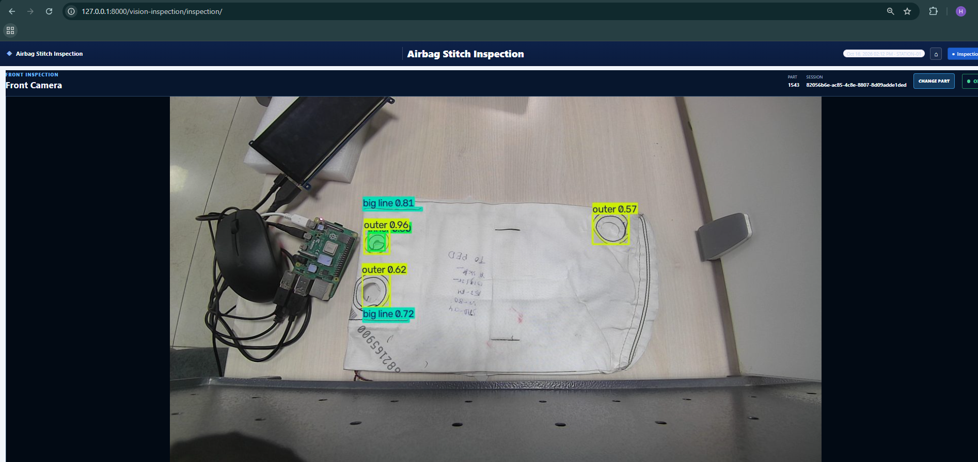

Slide 27
07
SFQA

Slide 28
SFQA - PHASE 1 OCTOBER PLANNED TASK
Operator Buddy - Phase 21
Task ID | Task Description | Team | Planned |  | Actual |  | Status | Responsibility | Remarks
 |  |  | Start Date | End Date | Start Date | End Date
Development & Deployement
1 | AI Integration in SFQA | Software | 13.10.26 | 20.10.26 | 13.10.26 | 16.10.26 | Closed | Naveen
2 | Train the dataset models for SFQA | Software | 21.10.26 | 30.10.26 |  |  | Open
LGB l Operations Technology

Slide 29
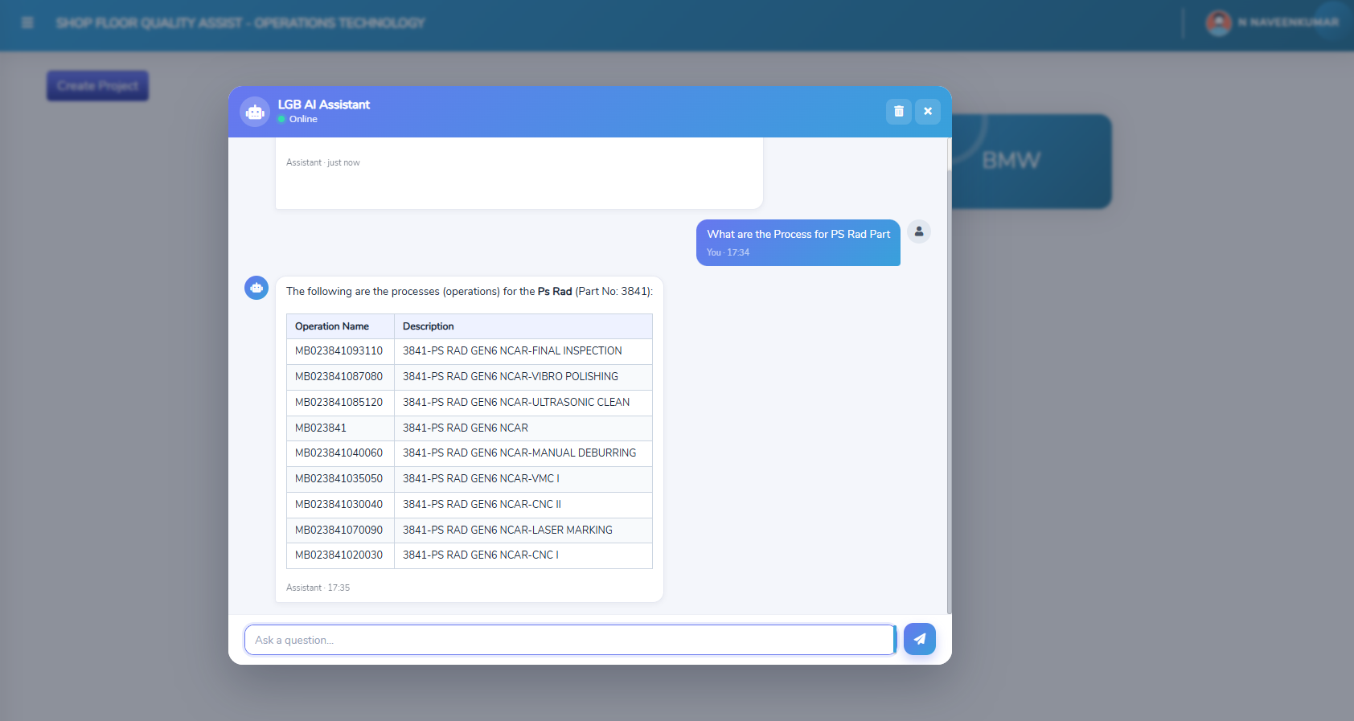

Slide 30
08
Complete List of Digitalization Projects 2026

Slide 31
S.No | WBS ID | Plant | Line | Task / Project | WBS Activity | Planned Start | Planned End | Actual Start | Actual End | Status | Responsibility | Dependency / Reason | Remarks
1 | 1 | K.Palayam | RAD | BMW Digitalization | PRISM & Operator Buddy Implementation – Machine Interlock | 01/10/2026 | 09/10/2026 |  |  | In Progress | Plant IT | Interlock completed for 7 machines; remaining 4 machines pending due to Ethernet connectivity issues.
 | 1.1 |  |  |  | Requirement confirmation | 02/10/2026 | 03/10/2026
 | 1.2 |  |  |  | Machine/PLC signal identification | 03/10/2026 | 04/10/2026
 | 1.3 |  |  |  | Plant-side wiring & network readiness | 04/10/2026 | 05/10/2026
 | 1.4 |  |  |  | Interlock logic implementation | 05/10/2026 | 06/10/2026
 | 1.5 |  |  |  | PRISM/Operator Buddy integration | 06/10/2026 | 07/10/2026
 | 1.6 |  |  |  | Machine-wise testing | 07/10/2026 | 08/10/2026
 | 1.7 |  |  |  | Deployment & handover | 08/10/2026 | 09/10/2026
2 | 2 | K.Palayam | RAD | BMW Digitalization | Data Collection from Machine | 12/10/2026 | 22/10/2026 |  |  | Pending | Plant IT | 6 machines completed. KM-TU-13 pending because the IP address is not responding to ping from the DB PC.
 | 2.1 |  |  |  | Requirement confirmation | 13/10/2026 | 16/10/2026
 | 2.2 |  |  |  | Machine/network readiness | 14/10/2026 | 17/10/2026
 | 2.3 |  |  |  | Signal/tag verification | 15/10/2026 | 18/10/2026
 | 2.4 |  |  |  | Edge device setup | 16/10/2026 | 19/10/2026
 | 2.5 |  |  |  | Data logging script preparation | 17/10/2026 | 20/10/2026
 | 2.6 |  |  |  | Testing & deployment | 18/10/2026 | 21/10/2026
 | 2.7 |  |  |  | Data validation & handover | 19/10/2026 | 22/10/2026
3 | 3 | K.Palayam | BOSCH | Bosch Digitalization | Data Collection from Machine | 09/10/2026 | 17/10/2026 |  |  | Completed | Gowtham | 13 machines completed; 1 machine pending due to relay wiring by maintenance.
 | 3.1 |  |  |  | Requirement confirmation | 10/10/2026 | 11/10/2026
 | 3.2 |  |  |  | Machine/network readiness | 11/10/2026 | 12/10/2026
 | 3.3 |  |  |  | Signal/tag verification | 12/10/2026 | 13/10/2026
 | 3.4 |  |  |  | Edge device setup | 13/10/2026 | 14/10/2026
 | 3.5 |  |  |  | Data logging script preparation | 14/10/2026 | 15/10/2026
 | 3.6 |  |  |  | Testing & deployment | 15/10/2026 | 16/10/2026
 | 3.7 |  |  |  | Data validation & handover | 16/10/2026 | 17/10/2026

Slide 32
S.No | WBS ID | Plant | Line | Task / Project | WBS Activity | Planned Start | Planned End | Actual Start | Actual End | Status | Responsibility | Dependency / Reason | Remarks
4 | 4 | K.Palayam | BMW | BMW Digitalization | Grinding Machine Datalogging | 09/10/2026 | 16/10/2026 |  |  | Pending | MBD | Datalogging is pending due to MBD assistance.
 | 4.1 |  |  |  | Requirement confirmation | 10/10/2026 | 10/10/2026
 | 4.2 |  |  |  | MBD communication | 11/10/2026 | 11/10/2026
 | 4.3 |  |  |  | OPC/PLC/tag verification | 12/10/2026 | 12/10/2026
 | 4.4 |  |  |  | Edge communication setup | 13/10/2026 | 13/10/2026
 | 4.5 |  |  |  | Datalogging script preparation | 14/10/2026 | 14/10/2026
 | 4.6 |  |  |  | Testing | 15/10/2026 | 15/10/2026
 | 4.7 |  |  |  | Deployment & validation | 16/10/2026 | 16/10/2026
5 | 5 | K.Palayam | BOSCH | Bosch Digitalization | Data Collection from Machine | 10/10/2026 | 17/10/2026 |  |  | Pending | Gowtham | IP addresses are mapped; data logging needs to be completed for 8 machines using MT-Link.
 | 5.1 |  |  |  | Requirement confirmation | 11/10/2026 | 11/10/2026
 | 5.2 |  |  |  | Machine/network readiness | 12/10/2026 | 12/10/2026
 | 5.3 |  |  |  | Signal/tag verification | 13/10/2026 | 13/10/2026
 | 5.4 |  |  |  | Edge device setup | 14/10/2026 | 14/10/2026
 | 5.5 |  |  |  | Data logging script preparation | 15/10/2026 | 15/10/2026
 | 5.6 |  |  |  | Testing & deployment | 16/10/2026 | 16/10/2026
 | 5.7 |  |  |  | Data validation & handover | 17/10/2026 | 17/10/2026
6 | 6 | Annur | CMBF | Furnace Dashboard | Data Logging from Furnace | 14/10/2026 | 22/10/2026 |  |  | Partially Completed | Gowtham | 1 furnace completed and data integrated into PRISM; remaining 1 furnace pending due to Ethernet connectivity.
 | 6.1 |  |  |  | Requirement confirmation | 15/10/2026 | 16/10/2026
 | 6.2 |  |  |  | Network/IP readiness | 16/10/2026 | 17/10/2026
 | 6.3 |  |  |  | Signal/tag verification | 17/10/2026 | 18/10/2026
 | 6.4 |  |  |  | Edge device communication | 18/10/2026 | 19/10/2026
 | 6.5 |  |  |  | Data logging script preparation | 19/10/2026 | 20/10/2026
 | 6.6 |  |  |  | Testing & deployment | 20/10/2026 | 21/10/2026
 | 6.7 |  |  |  | PRISM/dashboard integration & validation | 21/10/2026 | 22/10/2026
7 | 7 | Annur | Rotary Furnace | Furnace Dashboard | Data Logging from Furnace | 19/10/2026 | 06/11/2026 |  |  | Pending | MBD | Data logging for 14 furnaces is pending due to MBD assistance.
 | 7.1 |  |  |  | Requirement confirmation | 20/10/2026 | 31/10/2026
 | 7.2 |  |  |  | Network/IP readiness | 21/10/2026 | 01/11/2026
 | 7.3 |  |  |  | Signal/tag verification | 22/10/2026 | 02/11/2026
 | 7.4 |  |  |  | Edge device communication | 23/10/2026 | 03/11/2026
 | 7.5 |  |  |  | Data logging script preparation | 24/10/2026 | 04/11/2026
 | 7.6 |  |  |  | Testing & deployment | 25/10/2026 | 05/11/2026
 | 7.7 |  |  |  | PRISM/dashboard integration & validation | 26/10/2026 | 06/11/2026

Slide 33
S.No | WBS ID | Plant | Line | Task / Project | WBS Activity | Planned Start | Planned End | Actual Start | Actual End | Status | Responsibility | Dependency / Reason | Remarks
8 | 8 | PGR | SQF | Furnace Dashboard | Energy Meter Data Collection from Furnace | 05/10/2026 | 03/11/2026 |  |  | Pending | Plant Electrical | RS-485 converter device purchase from plant side is pending.
 | 8.1 |  |  |  | Requirement confirmation | 06/10/2026 | 28/10/2026
 | 8.2 |  |  |  | Meter/register mapping | 07/10/2026 | 29/10/2026
 | 8.3 |  |  |  | RS-485 converter procurement | 08/10/2026 | 30/10/2026
 | 8.4 |  |  |  | Modbus communication setup | 09/10/2026 | 31/10/2026
 | 8.5 |  |  |  | Data logging script preparation | 10/10/2026 | 01/11/2026
 | 8.6 |  |  |  | Testing & validation | 11/10/2026 | 02/11/2026
 | 8.7 |  |  |  | Dashboard integration | 12/10/2026 | 03/11/2026
9 | 9 | PGR | SQF | Furnace Dashboard | Furnace Charge-IN and Charge-OUT Data Collection | 05/11/2026 | 19/11/2026 |  |  | Pending | Plant Electrical | Data collection is pending due to wiring requirement from plant side.
 | 9.1 |  |  |  | Requirement confirmation | 06/11/2026 | 13/11/2026
 | 9.2 |  |  |  | Charge-IN/OUT signal identification | 07/11/2026 | 14/11/2026
 | 9.3 |  |  |  | Plant-side wiring | 08/11/2026 | 15/11/2026
 | 9.4 |  |  |  | Edge device input testing | 09/11/2026 | 16/11/2026
 | 9.5 |  |  |  | Data logging script | 10/11/2026 | 17/11/2026
 | 9.6 |  |  |  | Testing & validation | 11/11/2026 | 18/11/2026
 | 9.7 |  |  |  | PRISM/dashboard integration | 12/11/2026 | 19/11/2026
10 | 10 | PGR | CNC | CNC Digitalization | Data Collection from Machine | 06/10/2026 | 14/10/2026 |  |  | Pending | Gowtham | R&D support from OT side is required.
 | 10.1 |  |  |  | Requirement confirmation | 07/10/2026 | 08/10/2026
 | 10.2 |  |  |  | OT/R&D communication | 08/10/2026 | 09/10/2026
 | 10.3 |  |  |  | Machine communication/tag verification | 09/10/2026 | 10/10/2026
 | 10.4 |  |  |  | Edge device setup | 10/10/2026 | 11/10/2026
 | 10.5 |  |  |  | Data logging script preparation | 11/10/2026 | 12/10/2026
 | 10.6 |  |  |  | Testing & deployment | 12/10/2026 | 13/10/2026
 | 10.7 |  |  |  | Data validation & handover | 13/10/2026 | 14/10/2026
11 | 11 | P.Palayam | SQF | Furnace Dashboard | Data Collection from Furnace | 07/10/2026 | 14/10/2026 |  |  | Completed | Gowtham | Data collection is pending due to vendor assistance for IP change.
 | 11.1 |  |  |  | Requirement confirmation | 08/10/2026 | 08/10/2026
 | 11.2 |  |  |  | Network/IP readiness | 09/10/2026 | 09/10/2026
 | 11.3 |  |  |  | Signal/tag verification | 10/10/2026 | 10/10/2026
 | 11.4 |  |  |  | Edge device communication | 11/10/2026 | 11/10/2026
 | 11.5 |  |  |  | Data logging script preparation | 12/10/2026 | 12/10/2026
 | 11.6 |  |  |  | Testing & deployment | 13/10/2026 | 13/10/2026
 | 11.7 |  |  |  | PRISM/dashboard integration & validation | 14/10/2026 | 14/10/2026

Slide 34
S.No | WBS ID | Plant | Line | Task / Project | WBS Activity | Planned Start | Planned End | Actual Start | Actual End | Status | Responsibility | Dependency / Reason | Remarks
12 | 12 | P.Palayam | Chain | Press Dashboard | Data Collection from Stamping Press | 01/11/2026 | 08/11/2026 |  |  | Pending | Gowtham | R&D support from OT side is required.
 | 12.1 |  |  |  | Requirement confirmation | 02/11/2026 | 02/11/2026
 | 12.2 |  |  |  | Machine signal identification | 03/11/2026 | 03/11/2026
 | 12.3 |  |  |  | Plant-side wiring/network readiness | 04/11/2026 | 04/11/2026
 | 12.4 |  |  |  | Edge device setup | 05/11/2026 | 05/11/2026
 | 12.5 |  |  |  | Stroke/data logging script | 06/11/2026 | 06/11/2026
 | 12.6 |  |  |  | Testing & validation | 07/11/2026 | 07/11/2026
 | 12.7 |  |  |  | Dashboard integration | 08/11/2026 | 08/11/2026
13 | 13 | P.Palayam | Daimler | Daimler Line Digitalization | Data Collection from Machines and Display in PRISM | 05/10/2026 | 13/10/2026 |  |  | In Progress | Plant IT | Data collection from machines is pending due to Ethernet connectivity.
 | 13.1 |  |  |  | Requirement confirmation | 06/10/2026 | 07/10/2026
 | 13.2 |  |  |  | Machine/network readiness | 07/10/2026 | 08/10/2026
 | 13.3 |  |  |  | Signal/tag verification | 08/10/2026 | 09/10/2026
 | 13.4 |  |  |  | Edge device setup | 09/10/2026 | 10/10/2026
 | 13.5 |  |  |  | Data logging script preparation | 10/10/2026 | 11/10/2026
 | 13.6 |  |  |  | Testing & deployment | 11/10/2026 | 12/10/2026
 | 13.7 |  |  |  | Data validation & handover | 12/10/2026 | 13/10/2026
14 | 14 | P.Palayam | Daimler | Daimler Line Automation | Data Collection from COBOT PLC using Tags and Display in PRISM | 05/10/2026 | 13/10/2026 |  |  | In Progress | Plant IT | Waiting for Ethernet connectivity and switch installation.
 | 14.1 |  |  |  | Requirement confirmation | 06/10/2026 | 07/10/2026
 | 14.2 |  |  |  | COBOT PLC tag mapping | 07/10/2026 | 08/10/2026
 | 14.3 |  |  |  | Ethernet/switch readiness | 08/10/2026 | 09/10/2026
 | 14.4 |  |  |  | OPC/PLC communication testing | 09/10/2026 | 10/10/2026
 | 14.5 |  |  |  | Data logging script | 10/10/2026 | 11/10/2026
 | 14.6 |  |  |  | PRISM integration | 11/10/2026 | 12/10/2026
 | 14.7 |  |  |  | Testing & handover | 12/10/2026 | 13/10/2026
15 | 15 | P.Palayam | Stellantis | Stellantis Line Digitalization | Push Data from SQLite to MongoDB | 12/10/2026 | 20/10/2026 |  |  | Pending | Gowtham | Development/start activity planned; MongoDB data push implementation to be completed.
 | 15.1 |  |  |  | Requirement confirmation | 13/10/2026 | 14/10/2026
 | 15.2 |  |  |  | SQLite data validation | 14/10/2026 | 15/10/2026
 | 15.3 |  |  |  | MongoDB connection/configuration | 15/10/2026 | 16/10/2026
 | 15.4 |  |  |  | Data push script development | 16/10/2026 | 17/10/2026
 | 15.5 |  |  |  | Error handling & logging | 17/10/2026 | 18/10/2026
 | 15.6 |  |  |  | Testing | 18/10/2026 | 19/10/2026
 | 15.7 |  |  |  | Deployment & validation | 19/10/2026 | 20/10/2026

Slide 35
S.No | WBS ID | Plant | Line | Task / Project | WBS Activity | Planned Start | Planned End | Actual Start | Actual End | Status | Responsibility | Dependency / Reason | Remarks
16 | 16 | Valiyampalayam | SQF | Furnace Dashboard | Data Collection from Furnace | 27/10/2026 | 06/11/2026 |  |  | Pending | Gowtham | Data collection is pending due to Ethernet connectivity.
 | 16.1 |  |  |  | Requirement confirmation | 28/10/2026 | 31/10/2026
 | 16.2 |  |  |  | Network/IP readiness | 29/10/2026 | 01/11/2026
 | 16.3 |  |  |  | Signal/tag verification | 30/10/2026 | 02/11/2026
 | 16.4 |  |  |  | Edge device communication | 31/10/2026 | 03/11/2026
 | 16.5 |  |  |  | Data logging script preparation | 01/11/2026 | 04/11/2026
 | 16.6 |  |  |  | Testing & deployment | 02/11/2026 | 05/11/2026
 | 16.7 |  |  |  | PRISM/dashboard integration & validation | 03/11/2026 | 06/11/2026
17 | 17 | Nagpur | Sprocket | CNC Digitalization | Data Collection from CNC Machines | 01/10/2026 | 09/10/2026 |  |  | In Progress | Plant IT | Data collection is pending due to server PC arrival.
 | 17.1 |  |  |  | Requirement confirmation | 02/10/2026 | 02/10/2026
 | 17.2 |  |  |  | OT/R&D communication | 03/10/2026 | 04/10/2026
 | 17.3 |  |  |  | Machine communication/tag verification | 04/10/2026 | 05/10/2026
 | 17.4 |  |  |  | Edge device setup | 05/10/2026 | 06/10/2026
 | 17.5 |  |  |  | Data logging script preparation | 06/10/2026 | 07/10/2026
 | 17.6 |  |  |  | Testing & deployment | 07/10/2026 | 08/10/2026
 | 17.7 |  |  |  | Data validation & handover | 08/10/2026 | 09/10/2026
18 | 18 | Nagpur | Sprocket | Press Dashboard | Data Collection from Stamping Press | 01/11/2026 | 22/11/2026 |  |  | In Progress | Plant IT | Data collection is pending due to server PC arrival.
 | 18.1 |  |  |  | Requirement confirmation | 02/11/2026 | 02/11/2026
 | 18.2 |  |  |  | Machine signal identification | 03/11/2026 | 04/11/2026
 | 18.3 |  |  |  | Plant-side wiring/network readiness | 05/11/2026 | 18/11/2026
 | 18.4 |  |  |  | Edge device setup | 06/11/2026 | 19/11/2026
 | 18.5 |  |  |  | Stroke/data logging script | 07/11/2026 | 20/11/2026
 | 18.6 |  |  |  | Testing & validation | 08/11/2026 | 21/11/2026
 | 18.7 |  |  |  | Dashboard integration | 09/11/2026 | 22/11/2026

Slide 36
Current Week KPI Summary
Planned Activity | Location | Remarks | Responsibility
SAP review meeting with corp | K-Palayam | Completed | Vishnunirmalan
SAP ghant chart review | Jalna, Bangalore, Pantnagar, Nagpur, FPD2, LSP | Completed | Vishnunirmalan
Furnace batch validation – PGR review | All Plant | Completed | Vishnunirmalan,Muthuselvan
KG Conversion Deployment | Annur | Under development will be completed on or before 30th Oct 2026 | Vishnunirmalan,Maestro
nagpur review | PGR | Completed | Vishnunirmalan,Rajat,Gokul
Weekly report standardisation | SMD | Completed | Vishnunirmalan
PGR issue – route card wrong process | Ganapathy | Completed | Durga,Vishnunirmalan
Prism / OP Buddy overload issue validation | PGR | Completed | Durga, Vishnunirmalan
Inbit clarity from plants | Annur,PGR | Completed | Vishnunirmalan
LGB l Operations Technology

Slide 37
Next Week KPI Summary
Planned Activity | Location | Remarks | Responsibility
Process parameter from MTLink | K-Palayam & P-palayam | Not yet started | Vishnunirmalan
LAN Laying | Jalna, Bangalore, Pantnagar, Nagpur, FPD2, LSP | Infrastructure Readiness LAN survey | Vishnunirmalan
Pongaluru Press – coil issue |  | Under SAP testing - plant need to complete testing and provide feedback post needback changes need to be made in first stage entry BAPI | Vishnunirmalan,Gokul
Annur Maestro in PRISM | Annur | Under development | Vishnunirmalan, Hariharasudhan
History card POC (PGR) | PGR | Under development | Durga
OP Buddy POC W/O scan | PGR | Device need to be installed | Vishnunirmalan,Gowtham
Zebra evaluation | K-palayam,PGR | HHD scanner received,2D and 3D scanning tablets will be received on 23rd Oct | Vishnunirmalan
PGR funace completion | All SQF plants | CP data – single report - Completed (Under plant review) Red/green charge based on 10-minute time and set point - Inprogress Charge comparison based on part (furnace comparision) Single chart report on main screen History card printing (OP Buddy) Instrument calibration API to Prism trial Two report formats: history card and production report - Inprogress | Vishnunirmalan, Durga
LGB l Operations Technology

Slide 38
Total Projects 2026
Oct Project progress review
LGB | Operations Technology
Thank You

